Slide 1
Azure Machine Learning
Dae Woo Kim (daewoo.kim@)
Technology Evangelist
Microsoft Korea
https://aka.ms/azure-camp-jun

Slide 2
Agenda
Machine learning
Azure Machine Learning 소개
Machine learning 흐름 시연
비즈니스 시나리오 소개
요약

Slide 3

예측 - Prediction

Slide 4












과거의 데이터를 이용해 미래를 예측
Machine learning과 예측분석(predictive analytics)는 비즈니스 확장을 위한 핵심 역량
Churn analysis
Social network analysis
Recommenda-tion engines
Location-based tracking and services
Vision Analytics
Weather forecasting for business planning
Legal discovery and document archiving
Equipment monitoring
Advertising analysis
Pricing analysis
Fraud detection
Personalized Insurance

Slide 5
Machine learning - ?

Slide 6
Machine Learning
Subfield of computer science and statistics that deals with the construction and study of systems that can learn from data, rather than follow only explicitly programmed instructions
-Wikipedia

Slide 7
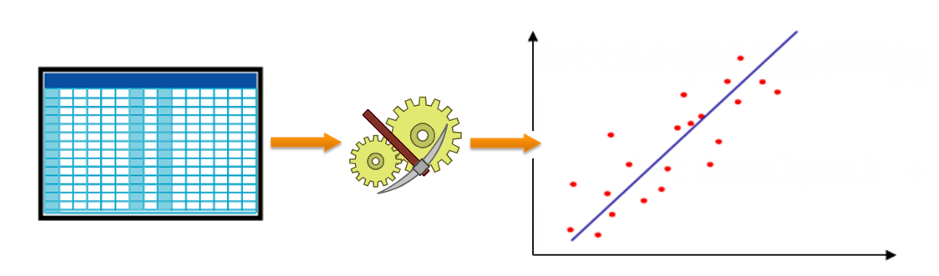
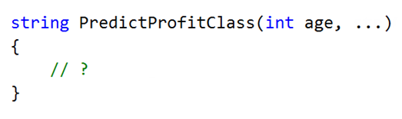
고객사의 수익 예측이 필요해
f(
)
Age, Marital Status, Gender, Yearly Income, Total Children, Education, Occupation, Home Owner, Commute Distance

Slide 8
Machine learning 워크플로우
Define Objective
Collect Data
Prepare Data
Train Models
Evaluate Models
Publish
Manage
Integrate

Slide 9

Machine learning 역할
Data scientist
A highly educated and skilled person who can solve complex data problems by employing deep expertise in scientific disciplines (mathematics, statistics or computer science)
Data professional
A skilled person who creates or maintains data systems, data solutions, or implements predictive modelling Roles: Database Administrator, Database Developer, or BI Developer
Software developer
A skilled person who designs and develops programming logic, and can apply machine learning to integrate predictive functionality into applications

Slide 10

Machine learning 난제
Strategic change
Lots of buzz words
New markets
High competition
Expensive
Traditional approach
Guessing
Rules of thumb
Trial and error
?
?
?
Isolated data
Tool chaos
Consequences
Lost opportunities
Expensive operative mistakes
Complexity
DATA
SCIENTIST

Slide 11
Azure Machine Learning 소개

Slide 12
Azure Machine Learning
강력한 클라우드 기반 예측 분석 가능
Advanced Analytics 솔루션을 손쉽게 빌드, 배포, 공유 가능
브라우저 기반 빠른 개발
다양한 Azure의 데이터 서비스들과 연계 가능
Azure HDInsight (Big Data)
Azure SQL Database, and
Virtual Machines

Slide 13
Azure Machine Learning 동작방식
Azure Portal
Azure Ops team
ML Studio
Data professionals & Data scientists
ML API service
Software developers

Slide 14
Demo: Azure Machine Learning workspace 배포
Notes:
Demo 1)

Slide 15
ML 워크플로우

Slide 16
Machine learning 워크플로우
Define Objective
Collect Data
Prepare Data
Train Models
Evaluate Models
Publish
Manage
Integrate

Slide 17
Machine learning 워크플로우
It is important to start a machine learning project with a clearly defined objective
Define Objective
…to deliver targeted display advertising on the company eCommerce web site, to:
Present relevant product suggestions
Increase sales and profitability
고객의 수익 예측이 필요해

Slide 18
Machine learning 워크플로우
Collecd complete data is critical
Garbage in ► Garbage out ☹
Datasets can be sourced from:
Internal sources, i.e. operational systems, data warehouse, etc.
External sources
Different formats, i.e. relational, multidimensional, text, map-reduce
Combining datasets can enrich data
E.g., integrate internal data to external data like weather, or market intelligence data
Collect Data

Slide 19
Machine learning 워크플로우
repare data for machine learning
Transform to cleanse, reduce or reformat
Isolate and flag abnormal data
Appropriately substitute missing values
Categorize continuous values into ranges
Normalize continuous values between 0 and 1
Of course, having the required data to begin with is important
When designing systems, give consideration to attributes that may be required as inputs for future modeling, e.g. demographic data: Birth date, gender, etc.
Prepare Data

Slide 20
Machine learning 워크플로우
This stage is iterative, and experimentation is reqinvolves:
Selecting a machine learning algorithm
Defining inputs and outputs
Optimizing by configuring algorithm parameters
Model evaluation is critical to determine:
Accuracy, Reliability, Usefulness
Train Models
Evaluate Models

Slide 21
Demo: ML Experiment 실행
Notes:
Demo 1)

Slide 22
Machine learning 워크플로우
First, add a scoring experiment
Transformational logic is replaced with a re-usable transformation resource
Training logic is replaced with a trained model
Web service inputs and outputs are added
Module properties can be parameterized
Publish the experiment to the gallery
Learn from others by discovering experiments
Contribute and showcase your experiments
Publish

Slide 23
Demo: ML 웹서비스
Notes:
Demo 1)

Slide 24
Machine learning 워크플로우
Each web service offers two methods:
Request/Response Service (RRS) ► Low latency, highly scalable web service
Batch Execution Service (BES) ► High volume, asynchronous scoring of many records
Integrate

Slide 25

Azure Machine Learning One solution for machine learning
Web Apps
Mobile Apps
Power BI/Dashboards
ML API service
Application Developer
Azure Portal
ML Studio
Azure Portal & ML API service
HDInsight
Azure Storage
Azure Ops Team
Azure Ops Team
Data Professional
Desktop Data

Slide 26
Azure Machine Learning One solution for machine learning
Business users easily access results from anywhere, on any device
Web Apps
Mobile Apps
Power BI/Dashboards
ML API service and the Application Developer
Tested models available as a URL that can be called from any endpoint
ML API service
Developer
Azure Portal
ML Studio
Azure Portal & ML API service
Azure Portal & ML API service and the Azure Ops Team
Create ML Studio workspace
Assign storage account(s)
Monitor ML consumption
See alerts when model is ready
Deploy models to web service
ML Studio and the Data Professional
Access and prepare data
Create, test and train models
Collaborate
One click to stage for production via the API service
HDInsight
Azure Storage
Azure Ops Team
Azure Ops Team
Data Scientist
Desktop Data

Slide 27





Cloud-based machine learning today
Faster towards solutions
Mashup of powerful algorithms
Quick and easy extensibility with cloud functions such as Power BI, Hadoop (Azure HDInsight) and cloud storage
Elastic, pay-as-you-go model with low operative costs
Global scaling of solutions via cloud API

Slide 28
Summary – Key Takeaway
Machine Learning is a subfield of computer science and statistics that deals with the construction and study of systems that can learn from data
Azure Machine Learning key attributes:
Fully managed ► No hardware or software to buy
Integrated ► Drag, drop, connect and configure
Best-in-class algorithms ► Proven solutions from Xbox and Bing
R built in ► Use over 400 R packages, or bring your own R or Python code
Deploy in minutes ► Operationalize with a click
Machine Learning is now approachable to developers

Slide 29
Resources
Azure Machine Learning web site
http://azure.microsoft.com/en-us/services/machine-learning
Azure Machine Learning documentation
http://azure.microsoft.com/en-us/documentation/services/machine-learning
Azure Machine Learning FAQ
http://azure.microsoft.com/en-us/documentation/articles/machine-learning-faq
Azure Machine Learning pricing
http://azure.microsoft.com/en-us/pricing/details/machine-learning/
Note: The Free tier does not require an Azure subscription or a credit card

Slide 30
Resources
Azure Machine Learning gallery
https://gallery.azureml.net
Azure Machine Learning blog
http://blogs.technet.com/b/machinelearning
Revolution Analytics
http://www.revolutionanalytics.com

Slide 31
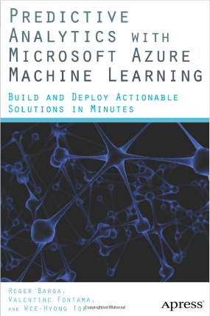
Resources
Book: “Predictive Analytics with Microsoft Azure Machine Learning: Build and Deploy Actionable Solutions in Minutes”
Publisher: Apress
Authors: Roger Barga, Valentine Fontama, and Wee Hyong Tok
Paul the octopus ☺
http://en.wikipedia.org/wiki/Paul_the_Octopus

Slide 32
Q&A

